Slide 1

USDA Agricultural Commodities Production Analysis
Insights for Strategic Planning and Decision Making
Francisco Vega Blanco, Data Analyst
29/05/2024

Slide 2
Overview of the Analysis
Purpose: To provide data-driven insights into the production of various agricultural commodities across different states.
Dataset: Milk, cheese, coffee, honey, and yogurt production data along with state lookup information.
Time Span: Multiple years.

Slide 3
Dataset Description
milk_production: Data on milk production across states.
cheese_production: Data on cheese production across states.
coffee_production: Data on coffee production across states.
honey_production: Data on honey production across states.
yogurt_production: Data on yogurt production across states.
state_lookup: Information linking state codes to state names.

Slide 4
Analysis Methodology
Data extraction and transformation using SQL.
Visualization and trend analysis using Tableau.
Key metrics: Total production, year-over-year changes, state rankings.

Slide 5
Total Milk Production in 2023
2023: $91,812,000
2022: $443,045,700
Milk production decreased by approximately 79.29% from 2022 to 2023.

Slide 6
Average Honey Production in 2022
The average honey production in 2022 is $3,133,275

Slide 7
States with Cheese Production > 100M in April 2023
2 states: California ($208,807,000) and Wisconsin ($289,699,000)
Market Focus: Focusing marketing efforts in these states could potentially yield better results due to their high production capacity.
Strategic Planning: Identifying and leveraging high-production states can enhance supply chain efficiency and market penetration.

Slide 8
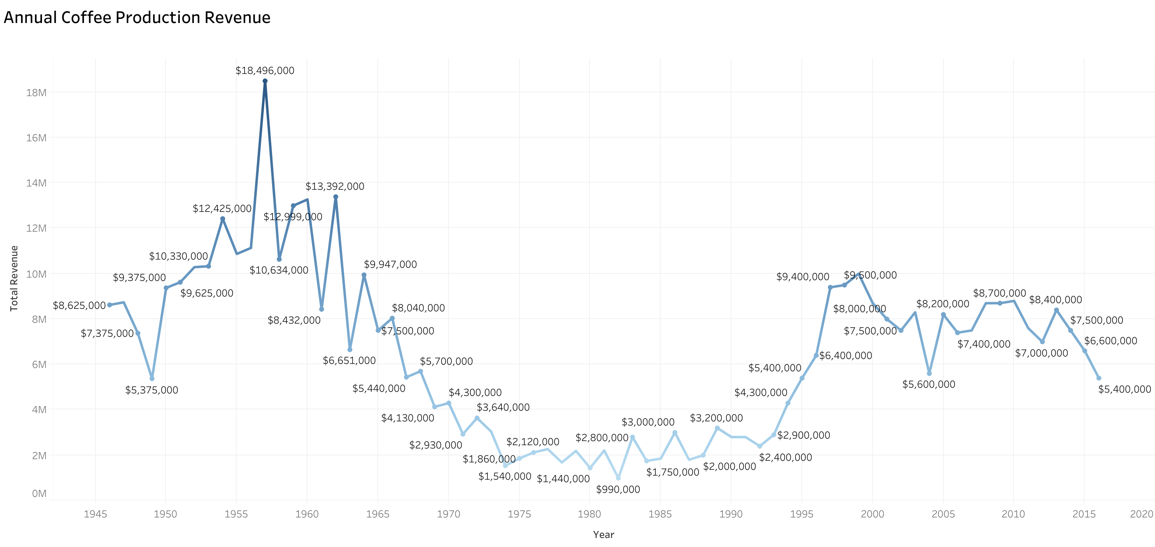
Coffee Production Trends
Top Producer: Hawaii (£5,400,000)
Total coffee production in 2011 is $7,600,000
Trend Insight: Over the years, coffee production shows fluctuations.
Strategic plans can focus on maintaining and boosting production levels in Hawaii.

Slide 9
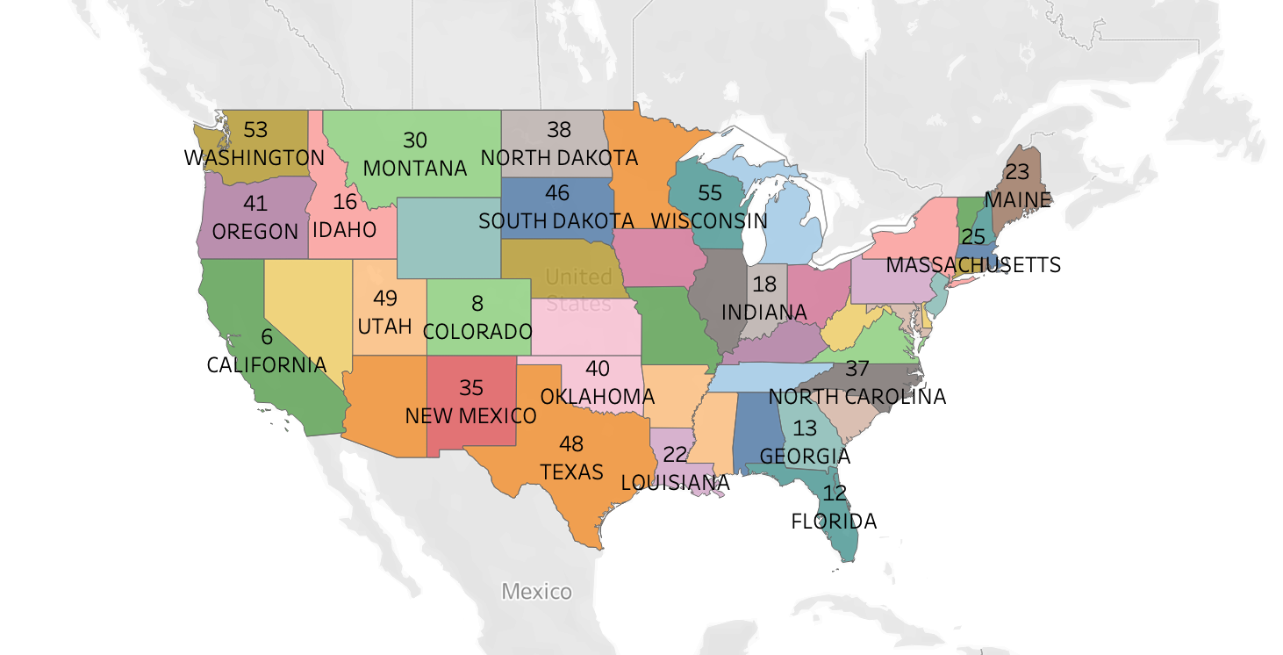
State Lookup - ANSI Codes
State ANSI Code for Florida is 12

Slide 10
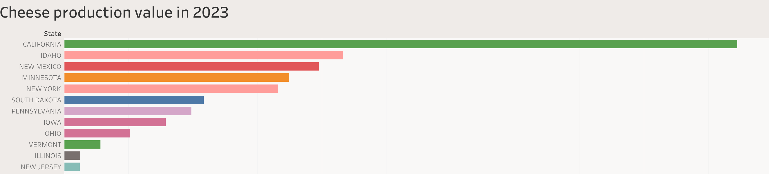
Cheese production value in April 2023
Cheese production for New Jersey is $4,889,000 in April 2023
Key Insight: Focus marketing efforts on California and Wisconsin due to high production levels.

Slide 11
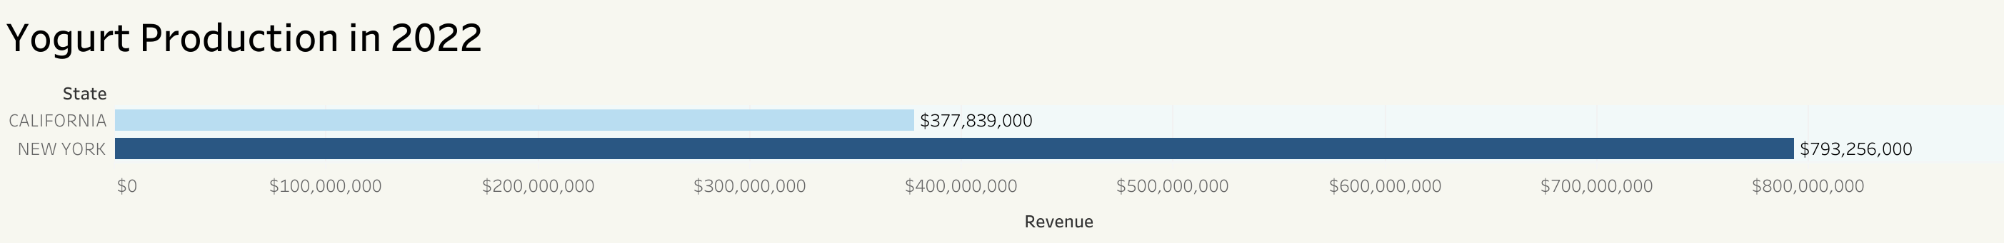
Yogurt Production in 2022
California produced $377,839,000
New York produced $793,256,000
Both states have produced a total of $1,171,095,000
Key Insight: New York and California are leading producers. Focus on sustaining their production levels.
California and New York also have cheese production data from 2023

Slide 12
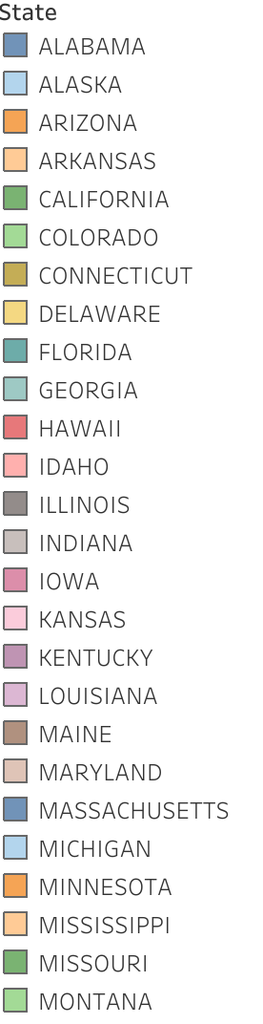
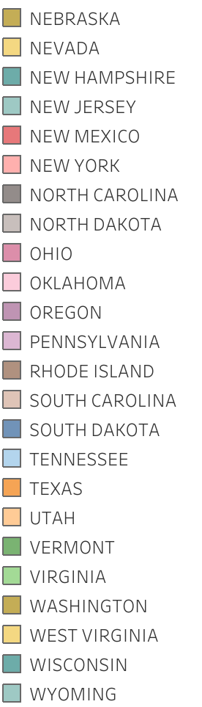
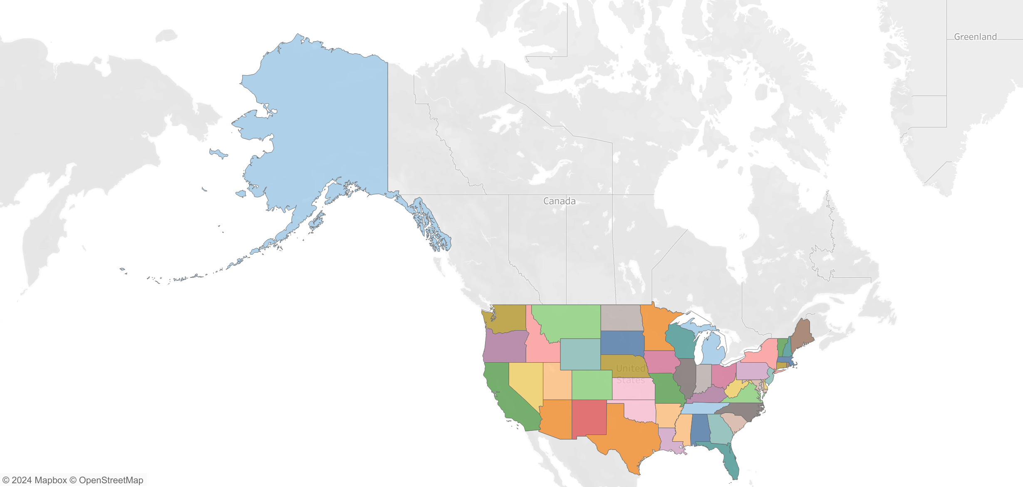
Missing milk production states in 2023
These are the 26 states that are missing from the milk production data of 2023

Slide 13
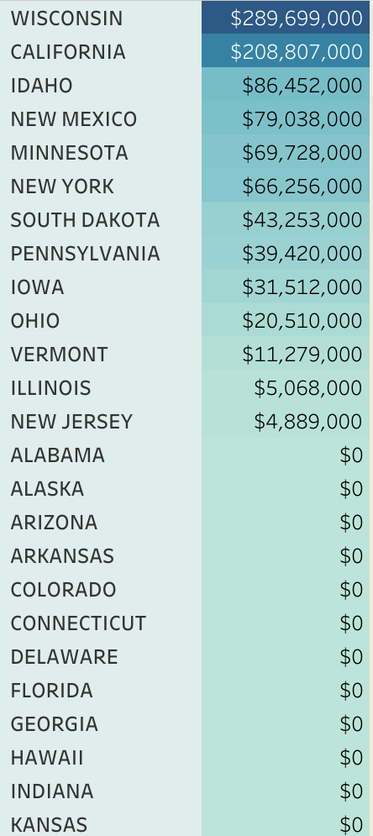
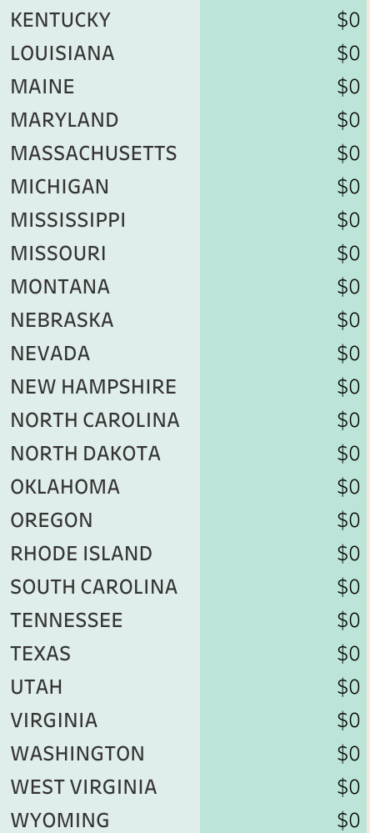
States with cheese production values in April 2023
Delaware did not produce any cheese in April 2023
States with no cheese production in April 2023 are presented upon the Data team request

Slide 14
Average Coffee Production For Years With Honey Production Greater Than 1 Million
The average coffee production for years with honey production greater than 1 million is $6,426,667

Slide 15
Trends And Anomalies
Cheese Production Trends
Trend: Steady production in leading states like California and Wisconsin.
Anomaly: States with traditionally low production levels remain consistent. No significant changes noted.
Coffee Production Trends
Trend: Fluctuating production levels in Hawaii.
Anomaly: A notable decrease from 2014 to 2016, suggesting potential issues that need addressing.
Honey Production Trends
Trend: California's production is significantly higher than other states.
Anomaly: Low production levels in many states suggest potential for growth.
Milk Production Trends
Trend: High production in key states like California and Wisconsin.
Anomaly: A significant drop from 2022 to 2023, suggesting an urgent need for investigation and mitigation.
Yogurt Production Trends
Trend: Consistent high production in New York and California.
Anomaly: Other states have minimal production, indicating potential areas for market expansion.

Slide 16
Data-Backed Suggestions for Areas Needing Attention
California and Wisconsin: For both milk and cheese, these states are critical. Ensuring stability and addressing any production issues here is paramount.
Hawaii: Focus on boosting coffee production and addressing any decline factors from previous years.
Other States for Honey: Potential growth opportunities in states other than California. Investments and strategies to boost honey production in states like Florida and others.
Yogurt Production Expansion: Encourage other states to increase yogurt production, leveraging the success seen in New York and California.

Slide 17
Further recommendations
Diversification: Encourage other states to diversify their production, especially in commodities where only a few states are dominant.
Investment in Technology: Invest in agricultural technology and practices to stabilize and increase production in underperforming states.
Strategic Planning: Develop state-specific strategies based on their production capabilities and historical data trends.

